Slide 1
Kasama sa Kalusugan
Youth Health Influencer
Training Workshop

Slide 2
Welcome!
Dear facilitator,
Welcome to the “Kasama sa Kalusugan - Youth Health Influencer Training Workshop.” You will be working with amazing young people from your community who want to help encourage positive health behaviors and attitudes among their peers. Your task is to orient them to the program and coach them to be effective Youth Health Influencers.
You may use these slides as visual aids and refer to the speaker notes for instructions or additional information. You are welcome to adjust the activities and examples to make them more relatable to your audience.
Your role as the training facilitator is crucial! We deeply appreciate the time and skills you dedicate to this important task.
Now, let’s get started!
Notes:
Skip/hide this slide for the workshop

Slide 3
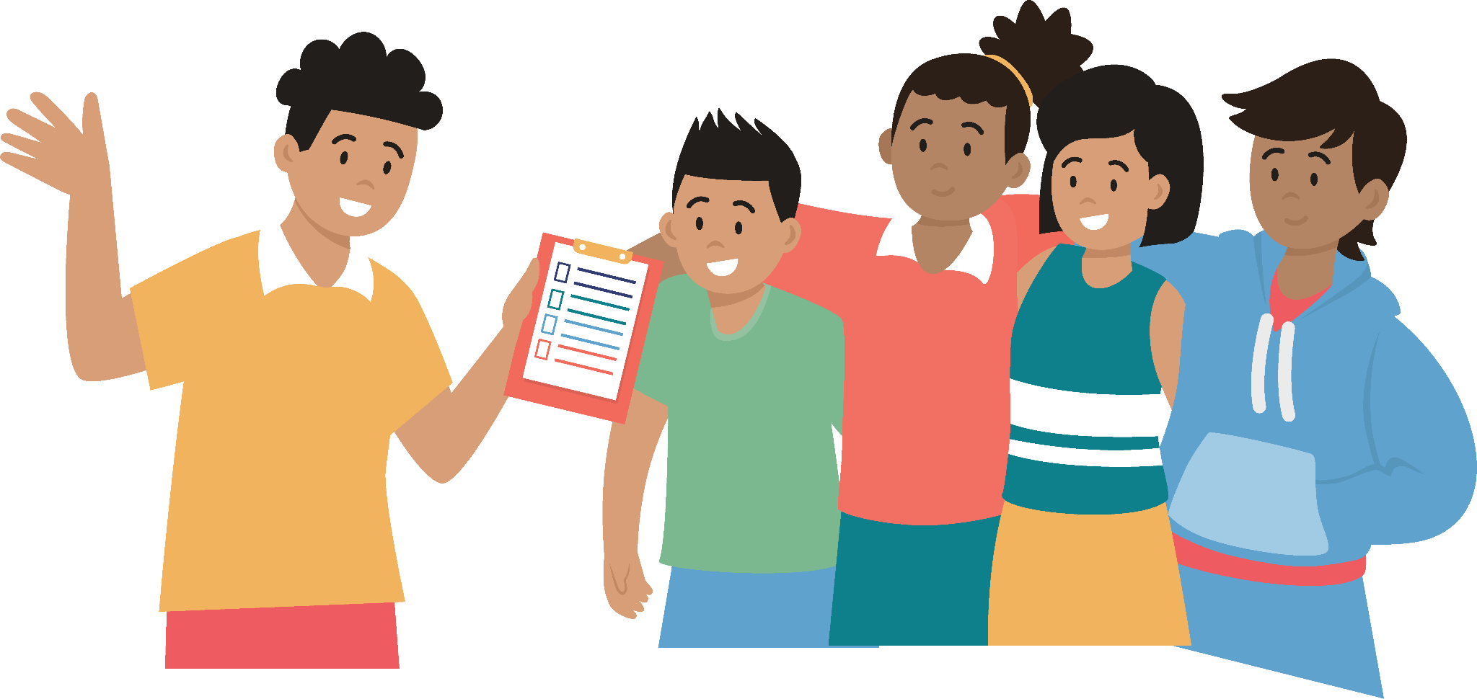
Tips for Facilitators
Notes:
Skip/hide this slide for the workshop

Slide 4
Set the level of expectation
Discuss and establish house rules at the beginning of the workshop.
Start with a prayer
Start the session with a universal or interfaith prayer
Break the ice!
Break the awkwardness with an icebreaker activity to get people relaxed and talking. Look here for some idea.
Look each person in the eye
Make eye contact with the participants when you are speaking.
Notes:
Skip/hide this slide for the workshop

Slide 5
Engage your participants
Ask participants questions in between sessions. If you feel that they are getting sleepy or bored, do a quick energizer activity or take a 5-min break to stretch!
Keep groups small and manageable
When breaking out into groups, try to keep the groups small to encourage active participation from each person. Mix up the participants if there are multiple group sessions. This will allow the participants to engage with different people.
Be firm, but not scary
If you find that participants are not observing the house rules, make a direct instruction. This might sound like:
“Can we have one person speak at a time during the feedback session, please? It is important we get to hear each other.”
“Let’s make sure we find a way to disagree while still respecting the other person.”
Notes:
Skip/hide this slide for the workshop

Slide 6
Be fair
Ensure that everyone is treated with respect. A good facilitator does not show favoritism to one person or a group of participants over others. Don’t comment about a person’s gender, sexual identity, religion, or ethnic group.
Leave them with a message
What do you want your participants to do and remember? Close each session with a takeaway message and a concrete call to action.
Notes:
Skip/hide this slide for the workshop

Slide 7
Introductions & House Rules
Program
Session 1: What is a Youth Health Influencer?
Session 2: Get to Know Your Community
Session 3: Credible Health Resources for Teens
Lunch
Session 4: Building Facilitation Skills
Session 5: Let’s Practice!
Session 6: Action Planning

Slide 8
Let’s get to know each other!
Notes:
Introduce yourself and the purpose of this workshop. Then, ask each participant to introduce themselves and share their preferred name. Follow this with an icebreaker activity.

Slide 9
Session 1: What is a Youth Health Influencer?
Notes:
The main objective of this session is to introduce the concept of Youth Health Influencer to the participants.
In this session we will:
A. Explore together the term “Influencer”
B.Discuss what it means to be a “HEALTH Influencer”
C.Assess current health issues in our community

Slide 10
What comes to your mind when you hear the word
‘influencer’?
Notes:
A. Explore the term “Influencer”
1. Ask the participants:
“What comes to your mind when you hear the word ‘Influencer’?”
You can also ask:
“What do you think it takes to be an influencer?”
“Who are the influencers you know?”
“Who influences your behavior and decisions?”
Participants can share their answers out loud or write them down on a post-it note and post them on the wall. Then, group similar answers together and discuss common themes.
2. Once the participants have answered the question/s, explain that anyone can be an influencer. Emphasize that every individual has the potential to positively influence their peers. They can become good and trusted influencers with the right agency, skills, and capacity.
3. Let them know that in this workshop, they will learn the necessary skills and resources to be influencers in their community.
B. Discuss what it means to be a “HEALTH Influencer”
Now that you’ve gathered participants’ common knowledge of the term “influencer,” continue the conversation by discussing and defining the characteristics of a Youth Health Influencer.
1. Start by asking the group, “When was the last time you received health information from someone? Who is that person?”
2. Next, go back to the key skills and capacities mentioned in the discussion of the term “influencer” and ask what they think are the characteristics of a health influencer.
Some answers might be:
➔ Trustworthy friend or peer
➔ Someone who is known for raising awareness about health issues
➔ Someone who knows about health resources
➔ Someone who likes to lead their peers or share new information
➔ Someone who has the motivation to bring about change in their lives and the lives of fellow teens

Slide 11
A Youth Health Influencer encourages peers to take better care of their health and well-being and connects them with the resources to do so
Notes:
You can point out any characteristics not mentioned and say:
“In this program, we are defining a Youth Health Influencer as someone who can encourage their peers to take better care of their health and well-being and connect them with the resources to do so. During this training you will learn about resources and short lessons (with slides, videos, activities, and discussion points) you can share with your peers so that you can be a credible and effective youth health influencer.”

Slide 12
What are the common health issues
in our community?
Notes:
C. Assess health issues in the community
Next, discuss the health issues in their community.
1. Ask participants what health issues they know of in their community or among their peers.
● You can ask general questions like “What are the common health issues in our community?” and then narrow it down to “What are the common health issues among you and your friends or other young people?”
● Ask the participants to put their answers on meta cards or post-its and post them on a piece of paper or the wall.
2. Group the health issues into clusters. Ask participants to share their thoughts about why some health issues are commonly mentioned.

Slide 13
What are the common health issues among young people
in our community?
Notes:
C. Assess health issues in the community
Next, discuss the health issues in their community.
1. Ask participants what health issues they know of in their community or among their peers.
● You can ask general questions like “What are the common health issues in our community?” and then narrow it down to “What are the common health issues among you and your friends or other young people?”
● Ask the participants to put their answers on meta cards or post-its and post them on a piece of paper or the wall.
2. Group the health issues into clusters. Ask participants to share their thoughts about why some health issues are commonly mentioned.

Slide 14
Session 2: Get to Know
Your Community
Notes:
The main objective of this activity is for participants to better understand their community by mapping out the health and social resources in their barangay/town.
1. Ask participants to group themselves according to their barangay. Give them 3 minutes to find their place in the session. Give each group a large piece of paper and some markers.

Slide 15
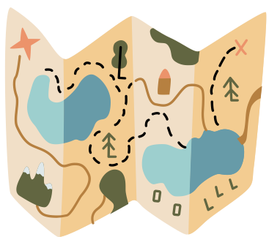
Draw a map of your barangay
Identify key community spaces where people usually go, such as:
schools
churches
government offices
health centers
market / mall
basketball court
Notes:
2. Ask them to draw a map of their barangay identifying key community buildings like schools, churches, government offices, etc. where community groups and members meet and other commonly used areas. They can identify health resources too and include individuals if they want. Give the groups 40 minutes to discuss and draw their maps.
3. Ask each group to creatively present their map. Give each group 5-10 minutes to present. Let the observers ask questions or comment at the end of each presentation.
BREAK (10-15 minutes)

Slide 16
Let’s take
a break!
Notes:
BREAK (10-15 minutes)

Slide 17
Session 3: Credible Health
Resources for Teens
Notes:
This session aims to introduce credible resources for teens to use as YHIs.

Slide 18
Who or where do you go to for health information?
Notes:
1. Ask participants where they get their health information. You can follow up with “Are there specific places you visit online? Or people you talk to? Which health facilities do you go to?”
You can discuss their responses as a group or ask the participants to write their answers on meta cards or post-its and post them on the wall for grouping and processing of common themes.
2. After the participants have shared their answers, acknowledge what is written or said and proceed with the discussion.
Reiterate that there are many ways and places to get information online and offline.
Emphasize that it is important to identify credible sources of information.
Spend a few minutes talking about false information. In fact, there is a whole module dedicated to this in the I CHOOSE to be Healthy modules.

Slide 19
What is False Information
False information is any statement or representation of a fact, whether written or verbal, that is untrue. There are different types of false information:
Rumors
Misinformation
Rapidly spreading stories or reports that may be true or false
The unintentional sharing of false or misleading information
Fake news
Disinformation
Imitates news content to appear as a credible source
The intentional sharing of false or misleading information with malicious intent to serve personal, political or economic agenda
Notes:
False information is any statement or representation of a fact, whether written or verbal, that is untrue. There are different types of false information:
Rumors are rapidly spreading stories or reports that may be true or false.
Fake news imitates news content to appear as a credible source.
Misinformation is the unintentional sharing of false or misleading information.
Disinformation refers to statements intentionally shared with malicious intent to serve a personal, political, or economic agenda.
In summary, fake news and disinformation are shared with the intent to deceive, while rumors and misinformation can be spread without the knowledge that the information being shared is not true.

Slide 20
Here are some
health resources
for youth
Notes:
Introduce the online and print resources we will use in this program. These are all endorsed by the DOH.

Slide 21
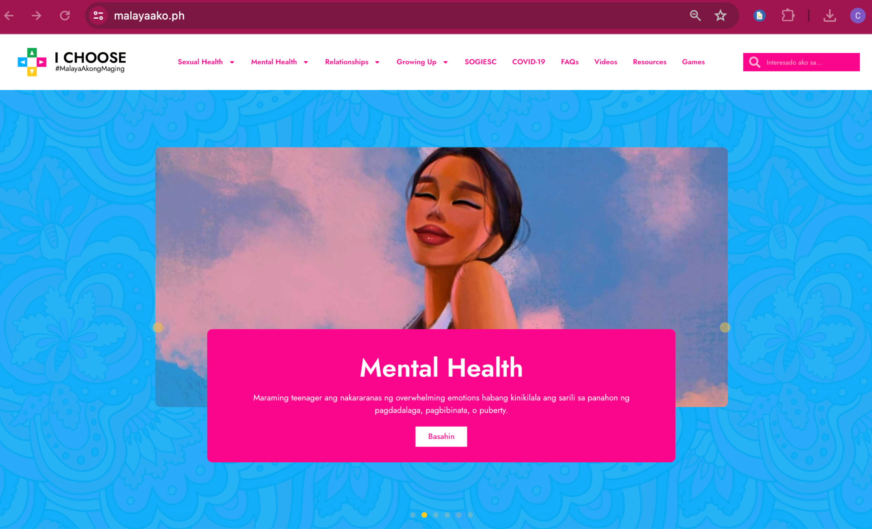
I CHOOSE website
Notes:
The main resource is the I CHOOSE #MalayaAkongMaging website (malayaako.ph), the Philippines' national platform for teen health. Show and quickly go through this website if you have internet connection, or you and the participants can access it on your phones.
Other credible resources include the Healthy Pilipinas and DOH websites and the WHO website.

Slide 22
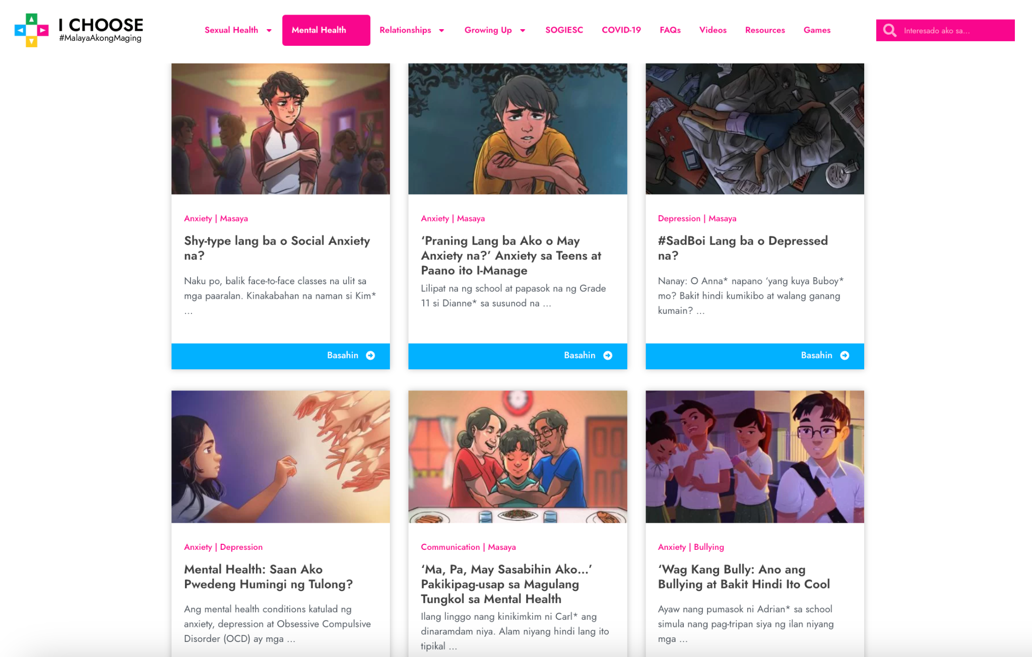
I CHOOSE website
Notes:
Click on the tabs to view different content per topic

Slide 23
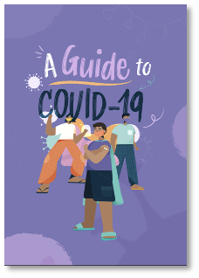
Booklets
Notes:
We use three booklets as resources for this program:
Gabay para sa COVID-19
A Moment for Myself: Taking Good Care of My Mind & Body on mental health, and
Malaya Akong Maging Malusog on teen health and relationships.
You can give the booklets and/or share the links.

Slide 24
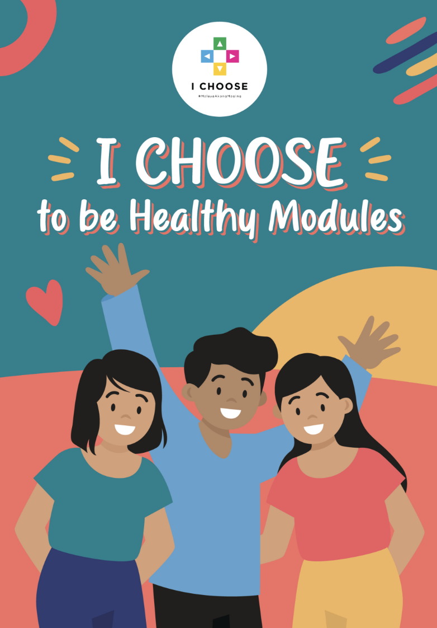
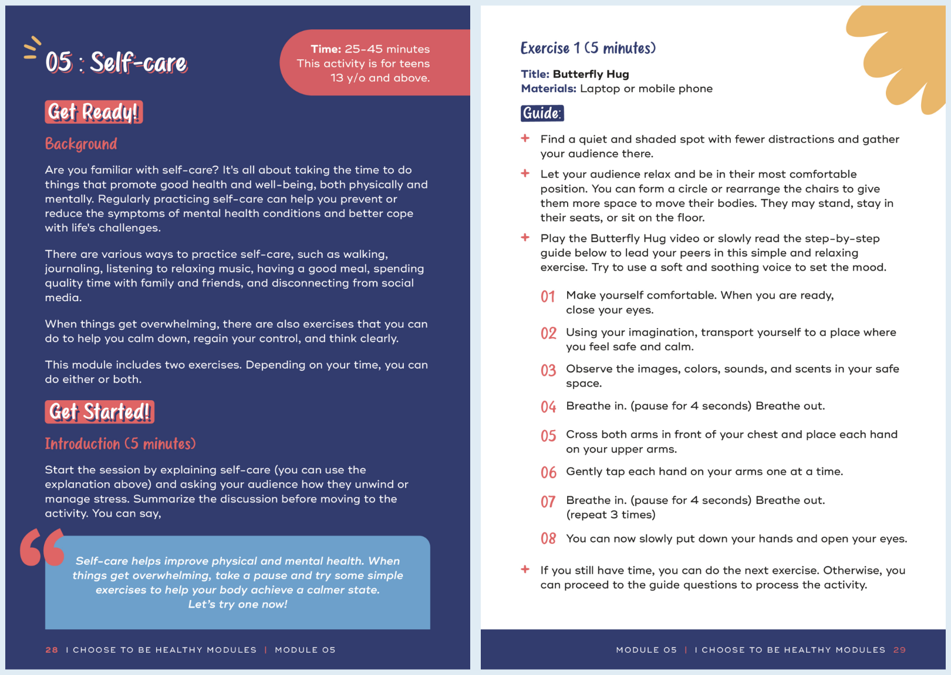
Modules
Notes:
I CHOOSE to be Healthy Modules. These are what the YHIs will share with their peers. There are short sessions on mental health, COVID-19 and emergency preparedness, false information, and teen health. Each session contains an introduction, activity, and links to resources. Over time, DOH and partners may add and share more short sessions.
4. Point out that the participants can also go to their nearest barangay health center or adolescent-friendly health facility if they need to consult with a professional or if they want to ask questions. Teachers and guidance counselors can also be good resources!
LUNCH

Slide 25
Lunch time!
Notes:
BREAK (10-15 minutes)

Slide 26
Session 4: Building Facilitation Skills
Notes:
Effective facilitation is crucial for Youth Health Influencers. This session aims to discuss various communication tools and strategies that participants can use as YHIs.
1. Ask the group to think of a class or workshop they enjoyed. What made the teacher or facilitator effective and enjoyable?
You can discuss as a group, or participants can write their answers on meta cards/post-its and post them on the wall for grouping and processing of common themes.
2. Next, go through the facilitation tips in the next slides. Make the session interactive by asking questions or role-playing.

Slide 27
Set the level of expectation
Discuss and establish house rules at the beginning of the workshop.
Start with a prayer
Start the session with a universal or interfaith prayer
Break the ice!
Break the awkwardness with an icebreaker activity to get people relaxed and talking. Look here for some idea.
Look each person in the eye
Make eye contact with the participants when you are speaking.

Slide 28
Engage your participants
Ask participants questions in between sessions. If you feel that they are getting sleepy or bored, do a quick energizer activity or take a 5-min break to stretch!
Keep groups small and manageable
When breaking out into groups, try to keep the groups small to encourage active participation from each person. Mix up the participants if there are multiple group sessions. This will allow the participants to engage with different people.
Be firm, but not scary
If you find that participants are not observing the house rules, make a direct instruction. This might sound like:
“Can we have one person speak at a time during the feedback session, please? It is important we get to hear each other.”
“Let’s make sure we find a way to disagree while still respecting the other person.”

Slide 29
Be fair
Ensure that everyone is treated with respect. A good facilitator does not show favoritism to one person or a group of participants over others. Don’t comment about a person’s gender, sexual identity, religion, or ethnic group.
Leave them with a message
What do you want your participants to do and remember? Close each session with a takeaway message and a concrete call to action.

Slide 30
Remember
Effective facilitators are also good listeners. Focus on what the other person is saying instead of what you want to say.
Your role as Youth Health Influencer is to connect your peers to appropriate resources that can provide proper counseling or treatment. You are NOT counselors or health care providers.
Notes:
Two points to emphasize:
1. Effective facilitators are also good listeners. Emphasize the importance of listening. Learning to listen is key to understanding situations and figuring out how to help connect a peer to the proper resources. Being a good listener means focusing on what the other person is saying instead of what you want to say, asking good questions, rarely interrupting someone, and reflecting on what they said to ensure you heard it correctly.
2. Lastly, explain that sometimes someone may talk about a personal or dangerous event or situation with a YHI. YHIs are NOT counselors or health care providers. Their role is to connect that person to an appropriate resource that can provide the proper counseling or treatment. They should not try to resolve a situation on their own.

Slide 31
Session 5: Let’s Practice!
Notes:
The main objective of this activity is for participants to familiarize themselves with the resources shared and practice using them. You can share the I CHOOSE to be Healthy Modules and Deck and give each participant the booklets if you haven’t already.
1. Ask participants to group themselves again according to their barangay and find a place in the venue. If the groups are too large, the participants can count off so each group has three to four people.
2. Explain the group activity:
● Each group will use the time to look through all resources and pick one short session to conduct in front of the entire group. Each short session is self-contained, meaning everything the YHI needs to know and do is in the module.
● It is recommended that each group pick a different topic. You can assign each group a topic, draw topics from a pile, or ask the groups to sort it out.
● Give the participants an hour to review the print and online resources and the module and practice.
● You should go around and observe each group and provide advice or feedback if asked.
3. Presentations:
● Each group will present one module to the audience if time permits. If not, ask each group to share their favorite part of the module.
● Audience members can give comments or ask questions at the end of the session. Watch how the presenting group members accept the feedback.
● You should give feedback and encouragement last. Ask how the person or people presenting felt. Acknowledge that giving and accepting feedback is sometimes hard, but we all need to be open to it.

Slide 32
Session 6: Action Planning
Notes:
In this last session of the day, each YHI will draft an action plan.
1. Share a printed copy of the Action Plan template.

Slide 33
Let’s take action!
Who do you want in your audience? How will you invite them?
Which health issue do you want to tackle? Which short session would you like to conduct?
What resources will you need?
Where can you do this?
When do you plan to conduct this activity?
Whose help do you need?
Can this be included in another activity?
Do you need a resource speaker?
Notes:
2. Ask the following guide questions. Think Who, What, Where, When?
● Which health issue do you want to tackle? Which short session would you like to conduct?
● Who do you want in your audience? How will you recruit them?
● What resources will you need?
● Where can you do this?
● When do you plan to conduct this activity?
● Whose help do you need?
● Can this be included in another activity?
● Do you need a resource speaker?
After about 20 minutes, ask a few YHIs to share their plans. Ask if there are any questions.

Slide 34
Thank
you!
Congratulations!
You are now a Youth Health Influencer!

